Slide 1

CI/CD: Web app deployment using TeamCIty
Case Study Presentation
Presented by:
R.H.A.L
Date Presented:
October 17, 2024

Slide 2

OpsWerks
Agenda
What is TeamCity
Discuss the different solutions
TeamCity as CI/CD
Web App Deployment
OPS Simulation
Version Control
Demo
Github Branch Protection

Slide 3
Objectives
Objectives and Limitations
Learn how to design and implementt CI/CD with TeamCity
Learn how version control can be integrated into CI/CD platform
Learn how to deploy a simple web application, apply the knowledge on how containers work and deploy it into Kubernetes (K8s)
Simulate operational incidents by intentionally introducing failures and follow written operations runbooks to resolve them
Limitations
Direct push or commits to the main branch are not allowed. Only through Pull Requests are permitted
Git branch protection cannot be enforced due to restrictions on the private repository
Only color names must be input in the environment variable; hex codes and empty values are not allowed
Opswerks

Slide 4

TeamCity
Is a powerful continuous integration (CI) and continuous deployment (CD) server
Developed by JetBrains.
It automates the process of building, testing, and deploying software, enabling teams to deliver high-quality applications more efficiently.

Slide 5
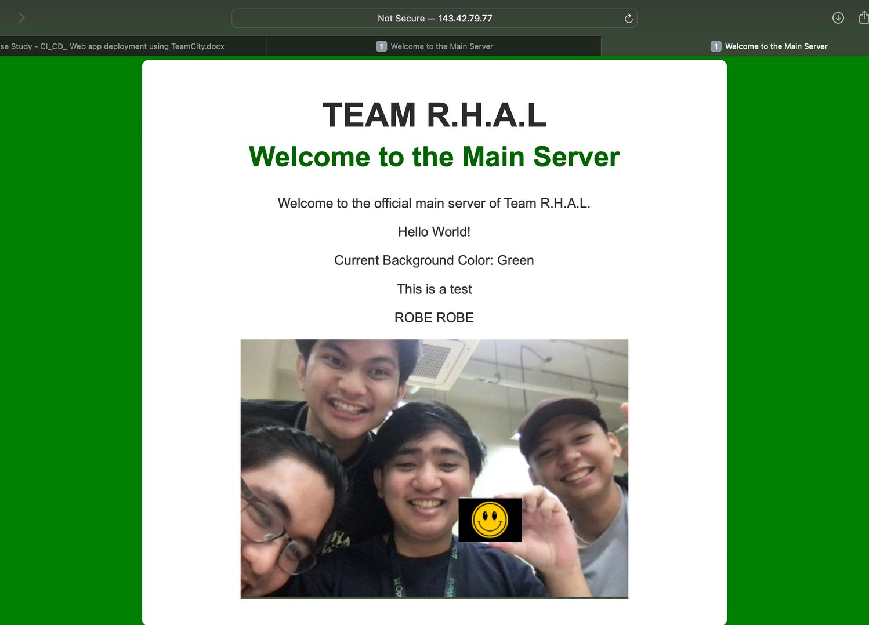
WEB APPLICATION
Displayed Colored Background
Accessible Over the Internet
Source Code must be built and compiled in TeamCity
App must be deployed in Kubernetes using canary deployment strategy

Slide 6

Version Control
Main Repo
Dev Repo
Pull Request

Slide 7

Opswerks
Github Branch Protection
PRs Must Have An Approval
Not Able To Directly Push To Main Branch
Status Check Must Be Implemented

Slide 8
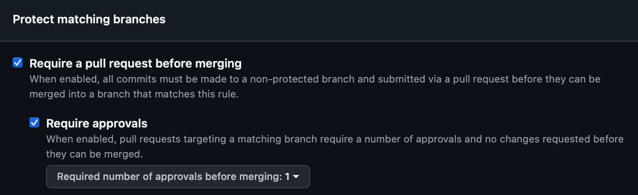
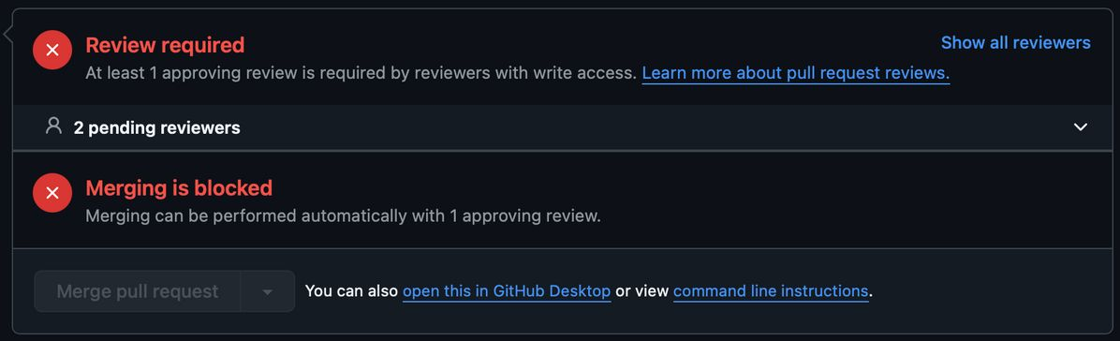
GitHub Branch Protection
PR APPROVAL
In the git branch protection, we were able to set the restriction to only allow pull requests before merging the dev branch to the main branch

Slide 9
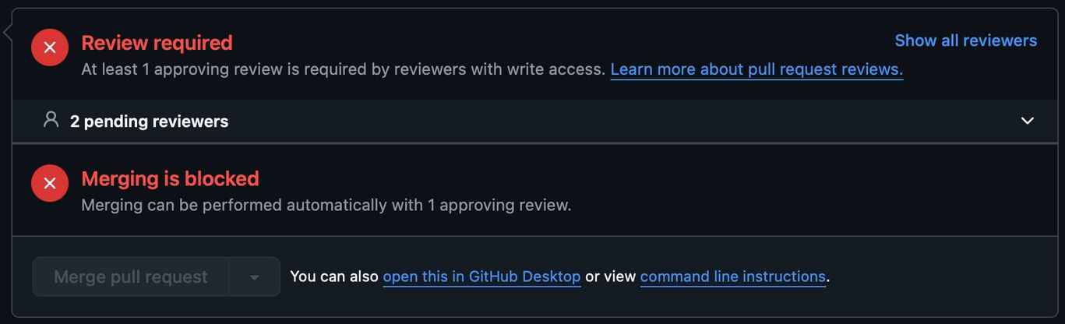
GitHub Branch Protection
PR APPROVAL
Shown above is the example if the Pull Request has not been approved/reviewed yet by any of the listed reviewers

Slide 10
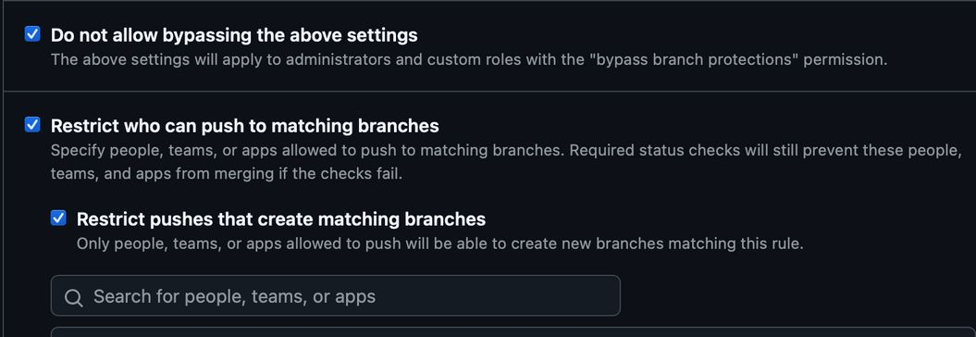
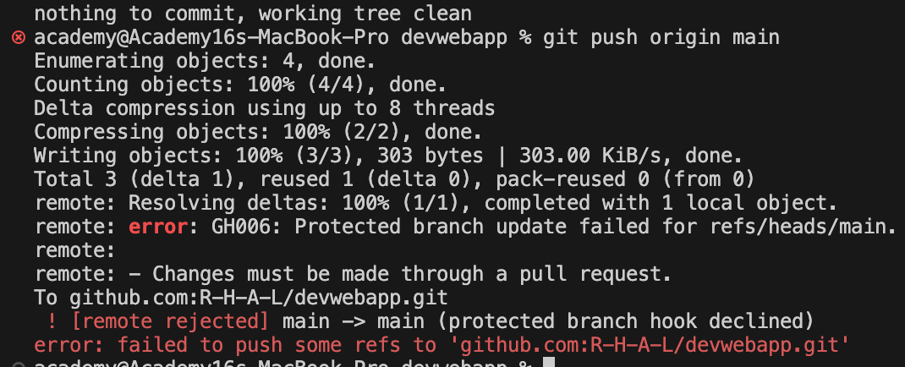
GitHub Branch Protection
Restrict Direct Push to Main Branch
In this restriction, this rule is made to never allow anyone (including administrator) to directly push to the main branch and without doing a pull request

Slide 11
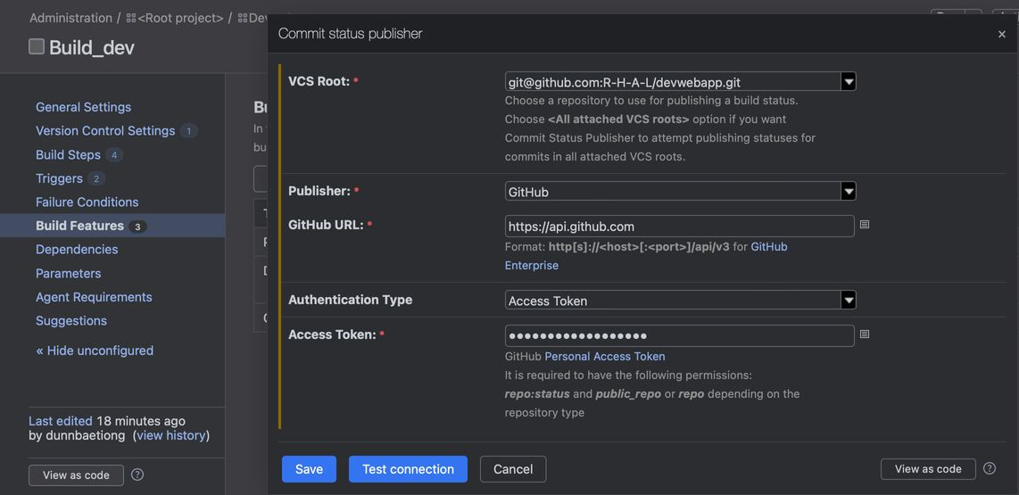
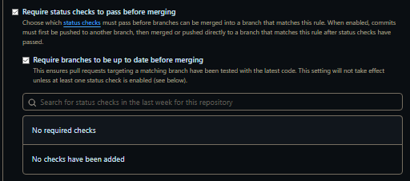
GitHub Branch Protection
Status Check Must Be Implemented
Status Check ensures that Github enforce checks on code changes before they can be merged into a branch

Slide 12
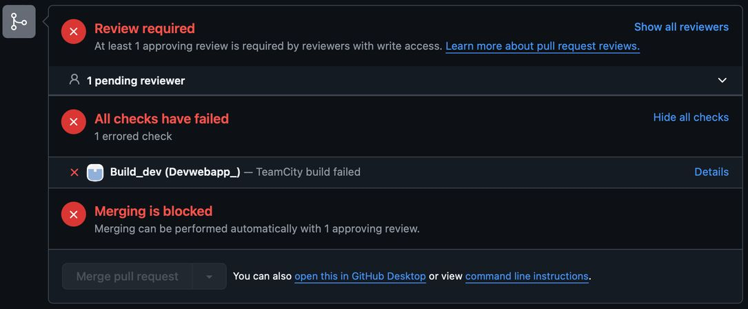
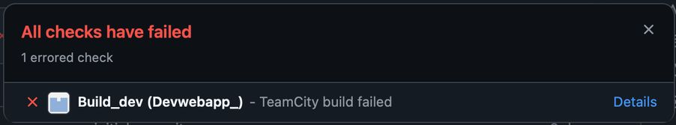
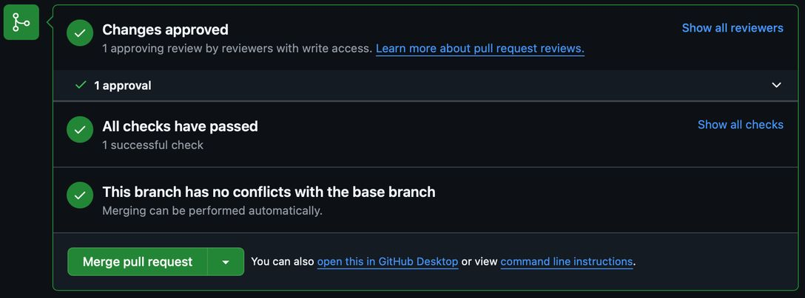
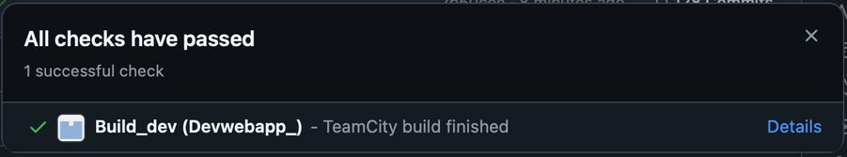
GitHub Branch Protection
Status Check Must Be Implemented
The First example shows what would happen if the build failed and can no longer continue for a pull requests
The Second example shows the successful build and shows that all checks have passed and is now allowed for merging

Slide 13

OPS Simulation
CI/CD Failures
Syntax or Logical Errors
Syntax or Logical errors are made within the code that would cause the build to failed due to misspellings, false data, no data at all

Slide 14
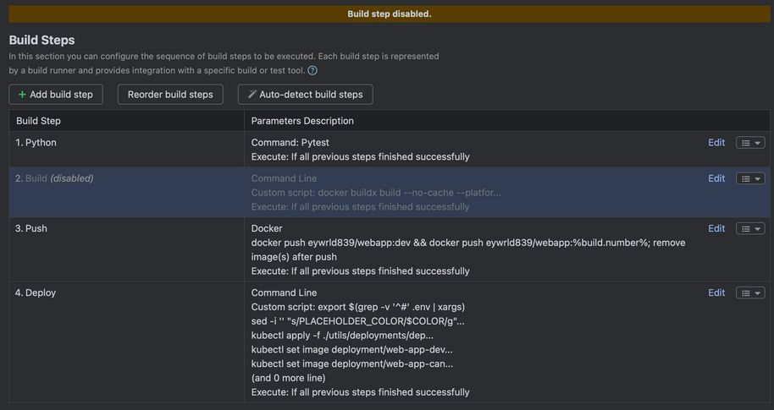
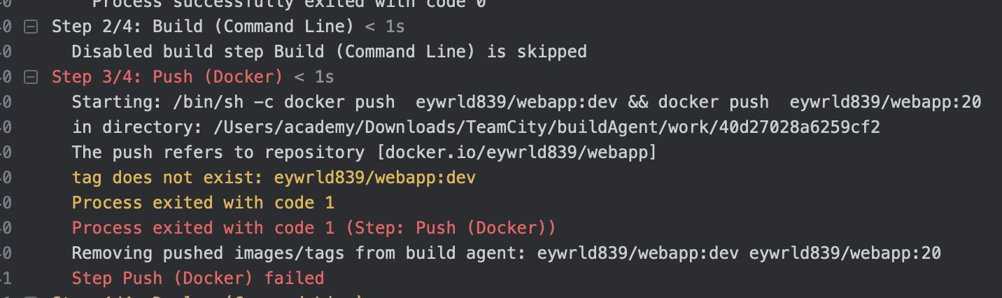
OPS Simulation
CI/CD Failures
Syntax or Logical Errors
Breaking Config Change
An example of breaking config change is by a build being disabled that would cause a build failure

Slide 15
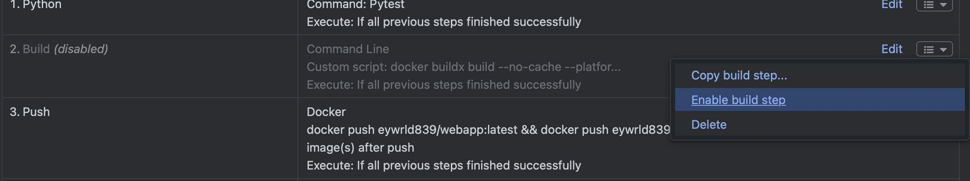
OPS Simulation
CI/CD Failures
Syntax/Logical Error Fix
Syntax or Logical Errors
Breaking Config Change
TeamCity Config Change
Apply the fix in Git/TeamCity

Slide 16
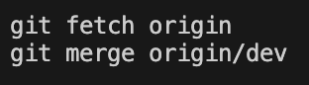
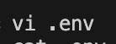

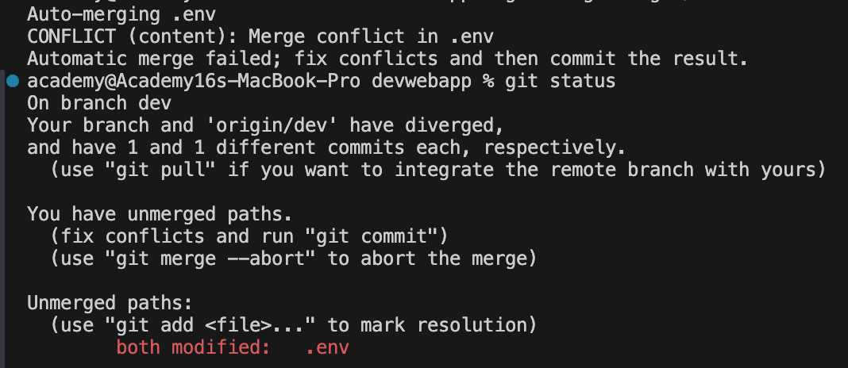
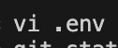
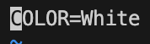
OPS Simulation
Version Control Failures
First POV
Merge Conflict
Second POV
Merge Conflicts happen whenever a file/data is modified between two places at the same time/same line

Slide 17
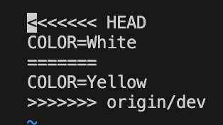

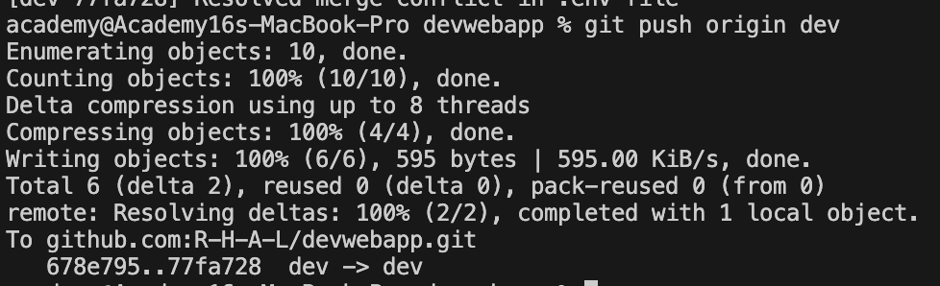
OPS Simulation
Version Control Failures
Merge Conflict
Resolve then Merge
Resolving a merge conflict would show you data of both the files and compare them to each other then manually filter the correct data

Slide 18
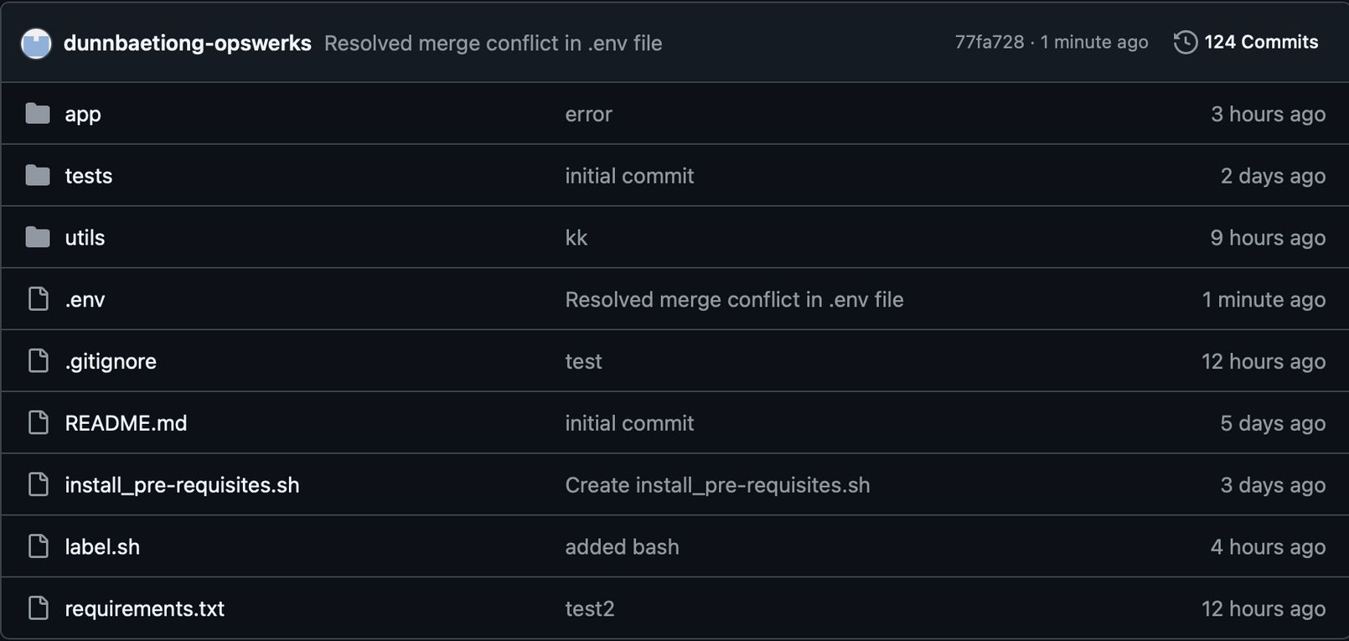
OPS Simulation
Version Control Failures
Merge Conflict
Resolve then Merge

Slide 19
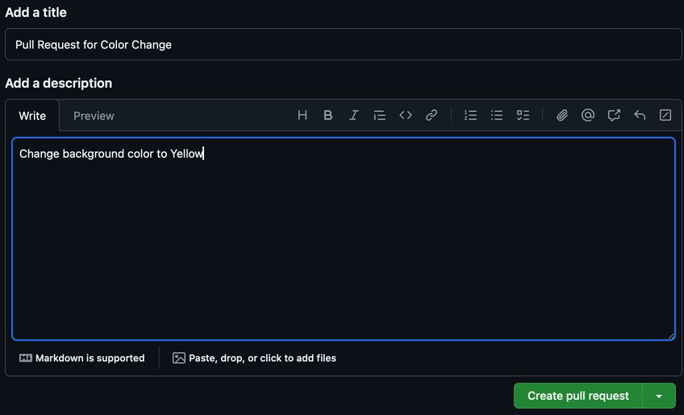
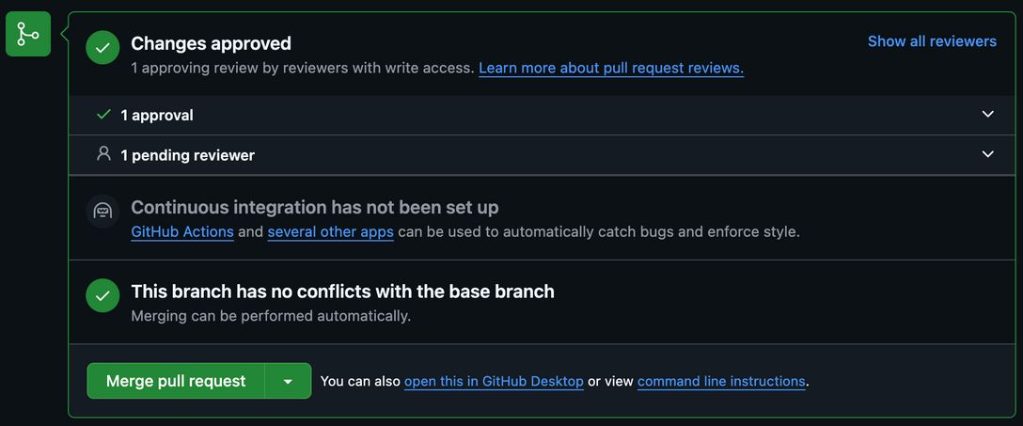
OPS Simulation
Version Control Failures
Merge Conflict
Resolve then Merge

Slide 20
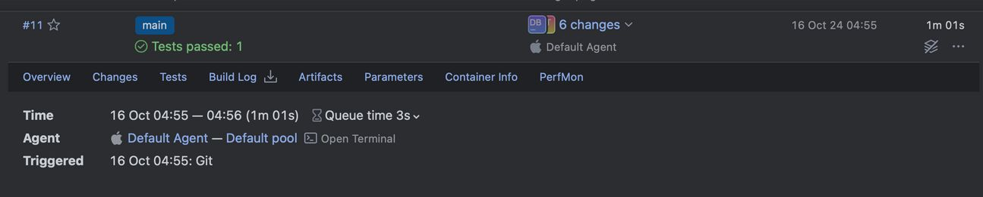
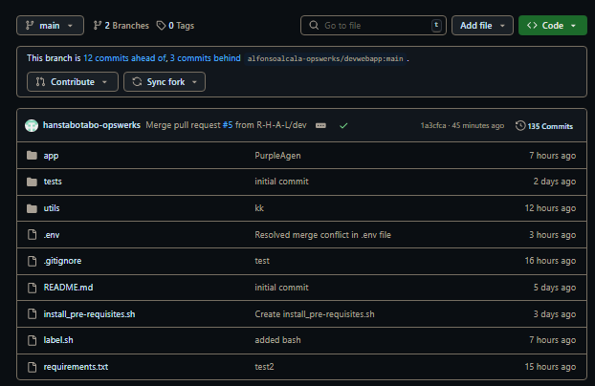
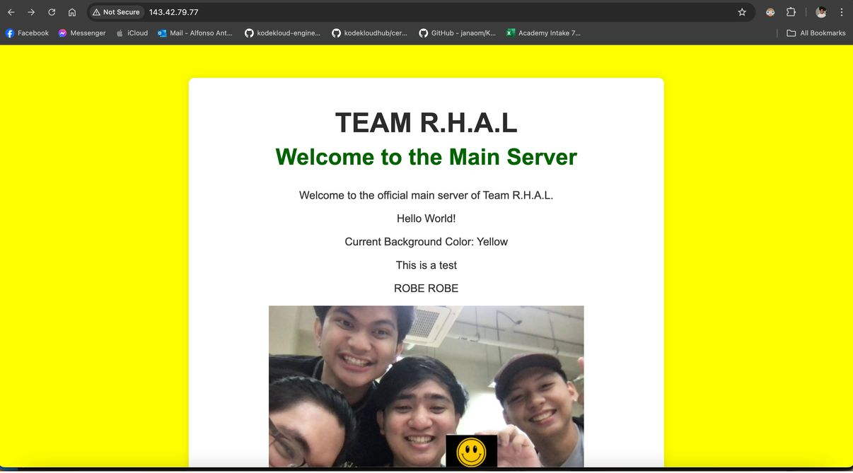
OPS Simulation
Version Control Failures
Merge Conflict
Resolve then Merge
Deploy App

Slide 21
OPSWERKS
RUNBOOK
Here is our Documentation of our Static Website

Slide 22
OPSWERKS
DEMO
Here is our Documentation of our Static Website

Slide 23
